Slide 1
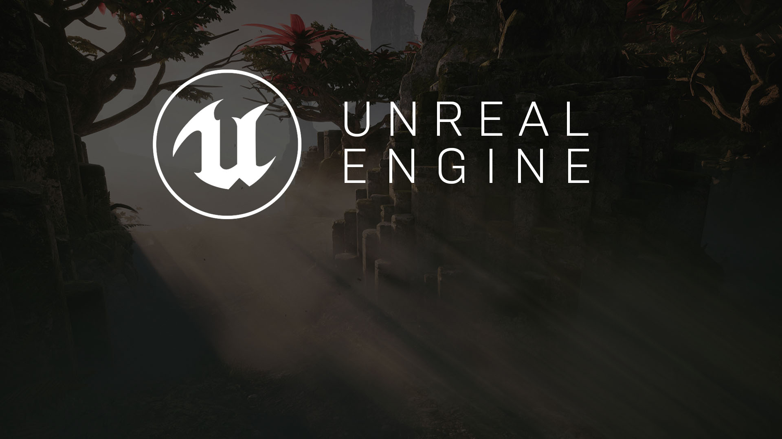
User Interfaces
Relaying Information to the Player

Slide 2
UI 101
The Basics

Slide 3
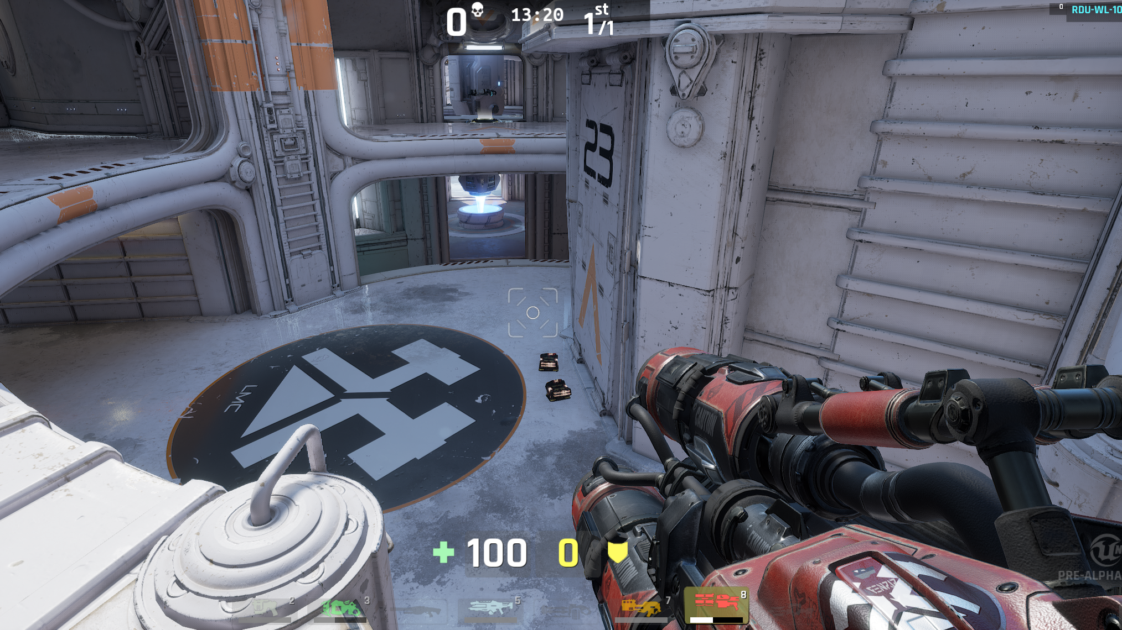

What is a User Interface?
The User Interface of a game is the set of methods and features that allow the player to interact with the game, and the game to provide information to the player. It can include a range of mechanics within the gameplay, input from controllers, menus, and HUDs and utilizes 2D and 3D art, sound, and physical feedback via controllers (rumble, haptic, force feedback).
More often than not, when people discuss User Interface, they are referring to either menus or HUDs. While these are important to most games, remember that other methods exist and in some cases can offer an easier or clearer user experience, or a more immersive experience. A recent trend in game design is to integrate menus and HUDs into the game world and story, a method called Diegetic Interfaces.

Slide 4
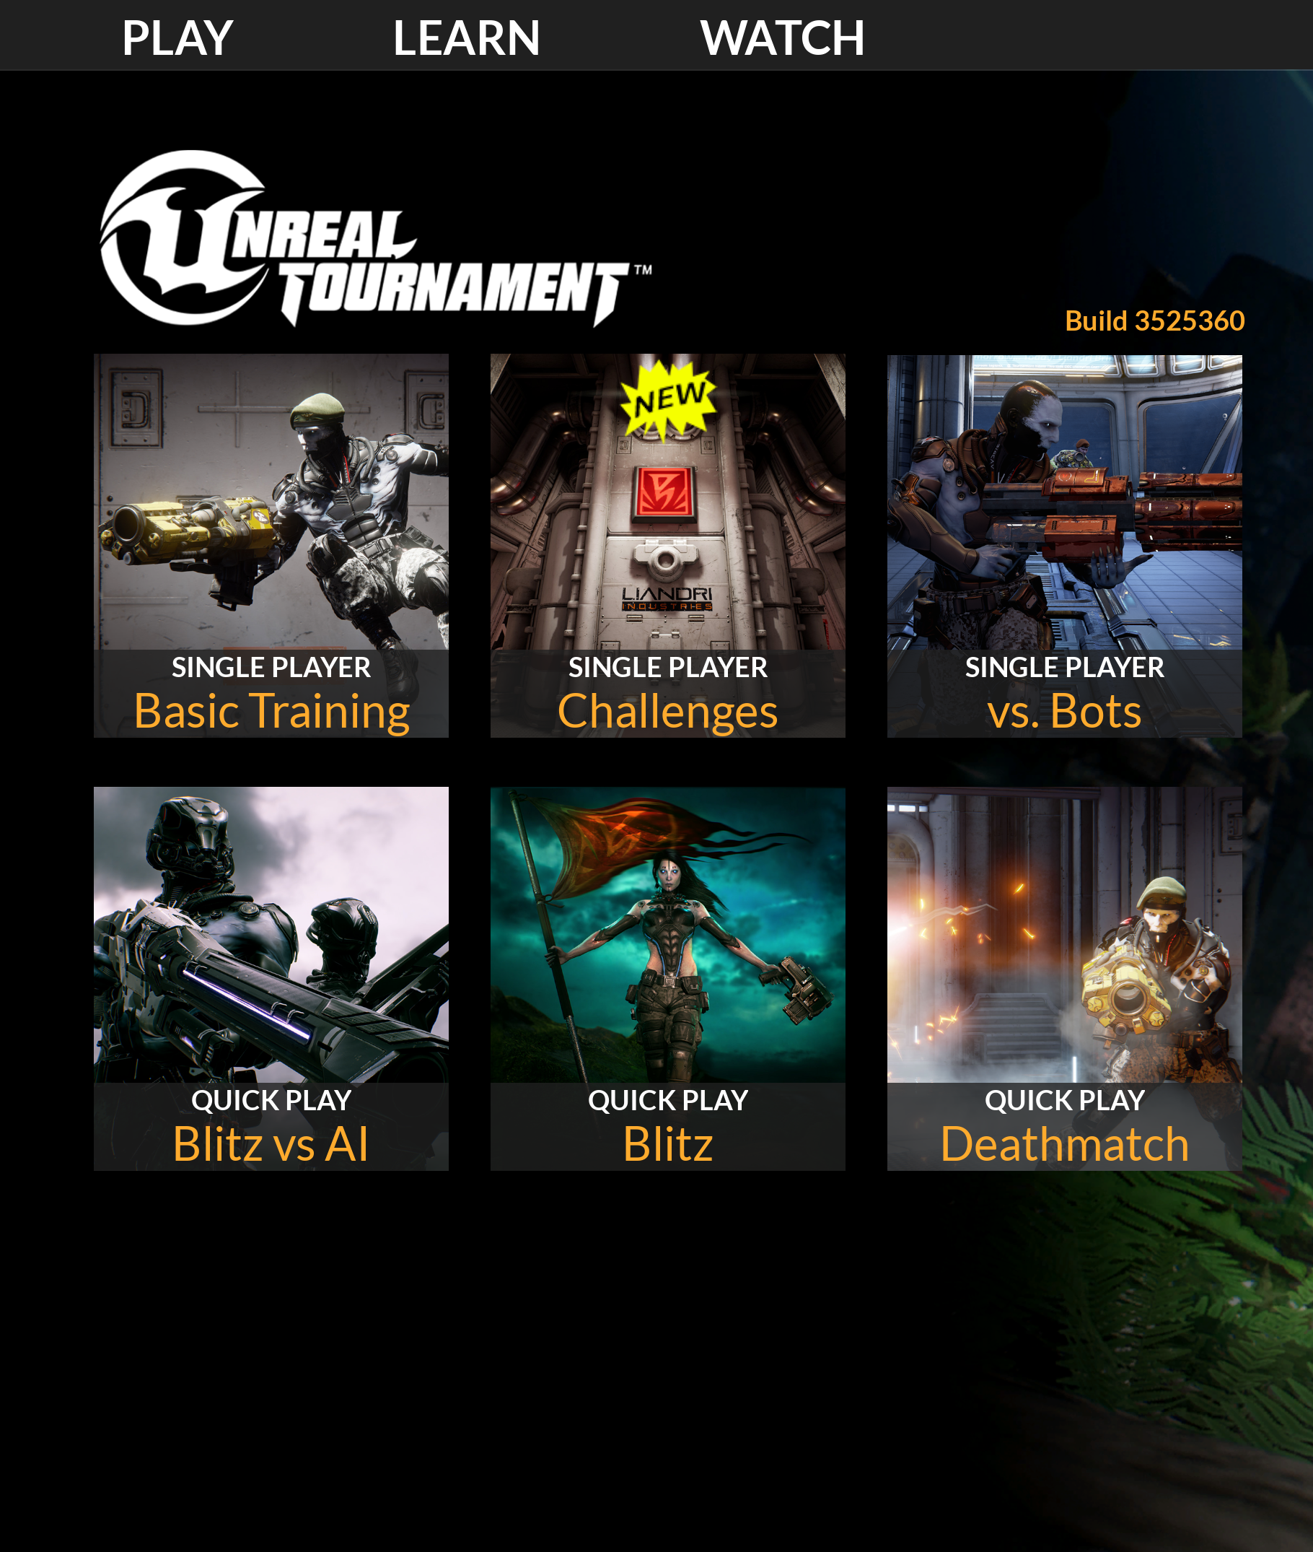
HUDs
A heads-up display, or HUD, is a common method of displaying important game information to players.
Menus
Menus are interactive interfaces that commonly allow players to move between different game states or set various configuration options.
Item Information
Assets within the world often need to convey information back to the player (for example, how long until the item respawns).
Interactive World Items
Systems such as locks, computer terminals, and conversation dialogue require separate user interface elements to work within the world. These are often driven through the same tools used to create screen user interfaces.

Slide 5
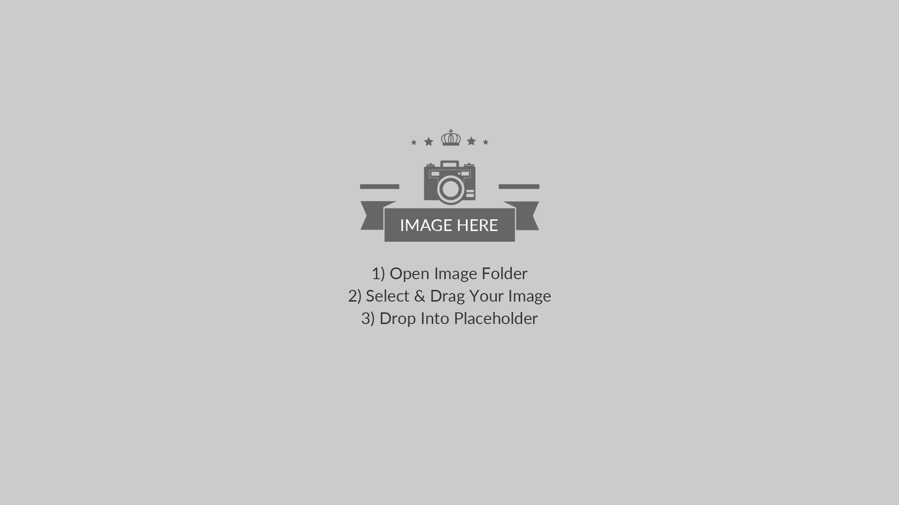

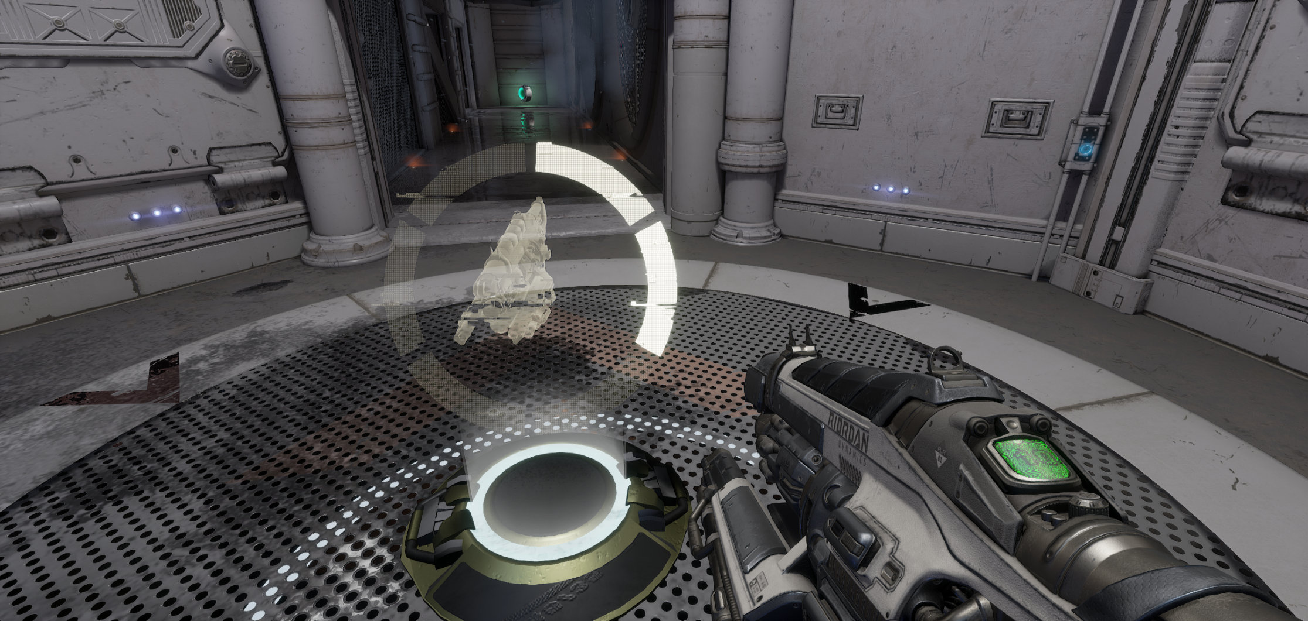
Unreal Tournament HUD
Weapon pickups in Unreal Tournament
Screen UI
World UI
User Interface elements are typically projected directly to the player’s viewport or screen as 2D elements. In the above example, we can see a game HUD with available weapons, health, armor, and other gameplay information.
Sometimes UI elements are built into the world. In this example, the time until the weapon respawns is displayed as a UI element on the weapon factory.

Slide 6
UMG
Unreal Motion Graphics UI Designer

Slide 7
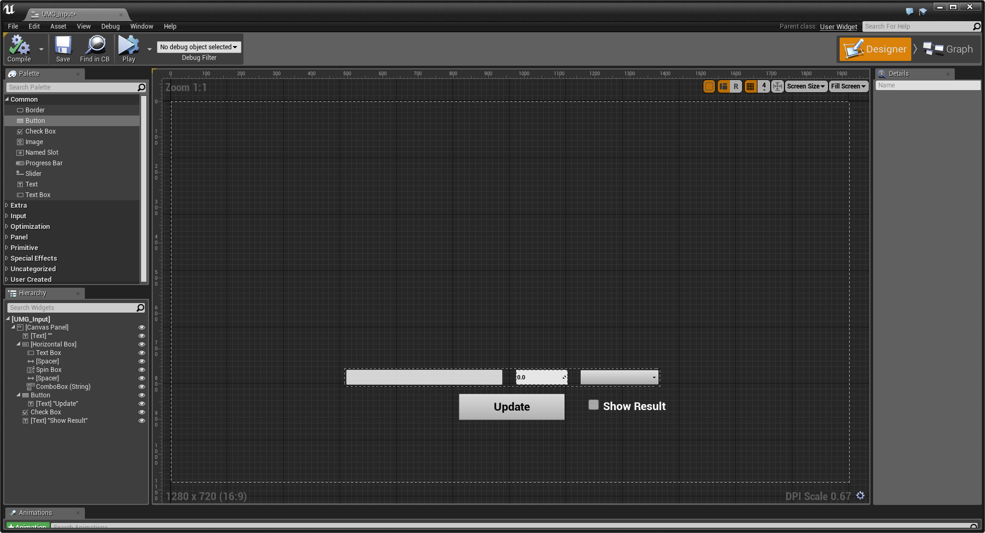
UMG Editor
Unreal Motion Graphics UI Designer (UMG) is a visual UI authoring tool that can be used to create 2D UI elements inside Unreal Engine. These elements can be displayed directly on the screen as well as within the game world or as part of 3D meshes.

Slide 8
UMG is the entry point for UI development in Unreal Engine.
The main building blocks of UMG are Widgets. A Widget can be added to another Widget, which can then be added to a third Widget, creating a hierarchical structure. This method of creation is known as composition. When Widget A is added to Widget B, Widget B is now referred to as the parent of Widget A, which is referred to as the child of Widget B. The parent Widget now can control a range of properties of the child Widget, including where it is rendered, how big it is, and whether or not it is visible.
Not all Widgets can contain other Widgets. To be able to contain another Widget, a Widget must have a Slot. A Widget can have a set number of Slots, or allow any number of Slots. A Slot may allow the child Widget to specify some properties about how it would like to be displayed. What those properties are and how they are used are up to the parent Widget, however.

Slide 9
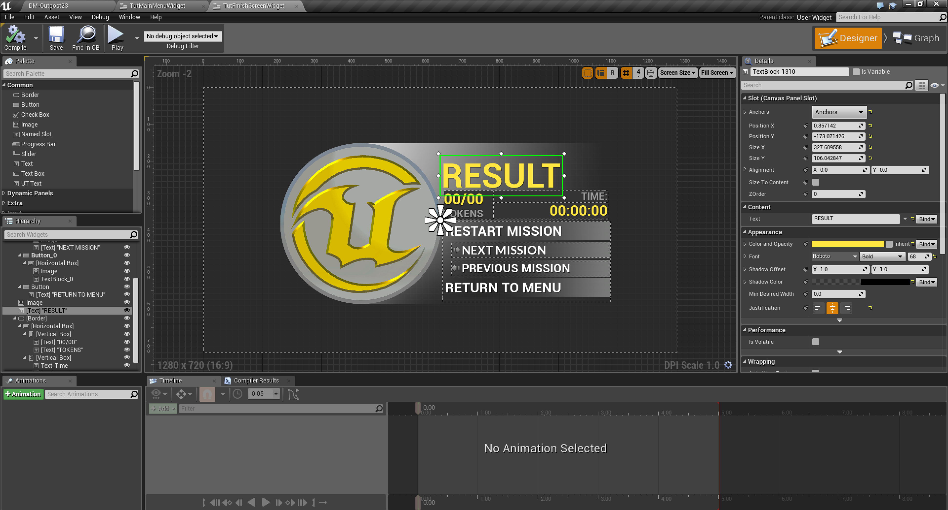
Key Widget Types
There are many types of pre-built Widgets within UMG.
Some Widgets are designed to display information or take information from players, while others are used to help format and control the layout and positions of Widgets.
Panels
Display Widgets
Input Widgets
User Widgets
Examples of UI Widgets in UMG

Slide 10
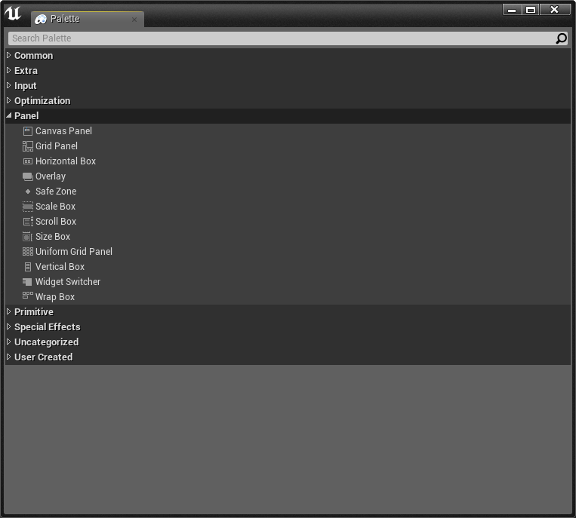
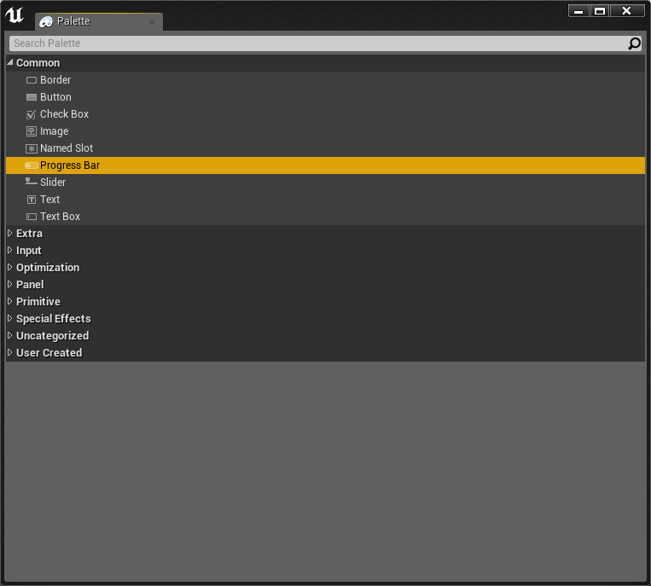
Panel Types
Common Display Widgets
Panels
Display Widgets
Panels control the layout and placement of other Widgets.
Display Widgets, such as Text and Images, display information to the player. There are a range of pre-built Display Widgets to help with more complex ways of displaying information, such as a Progress Bar.

Slide 11
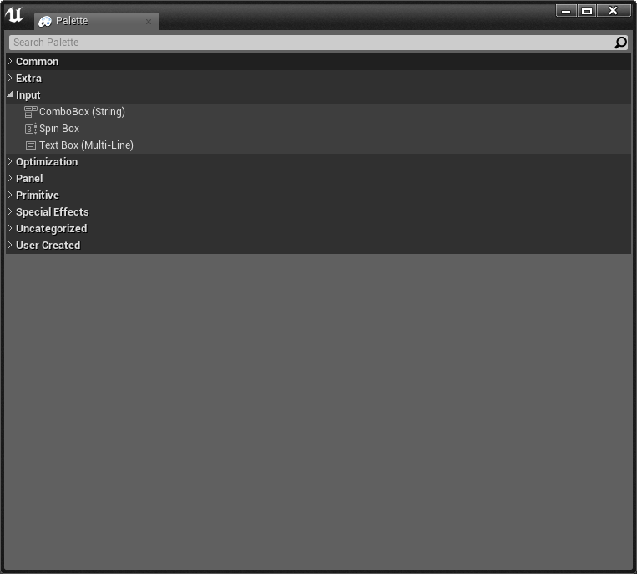
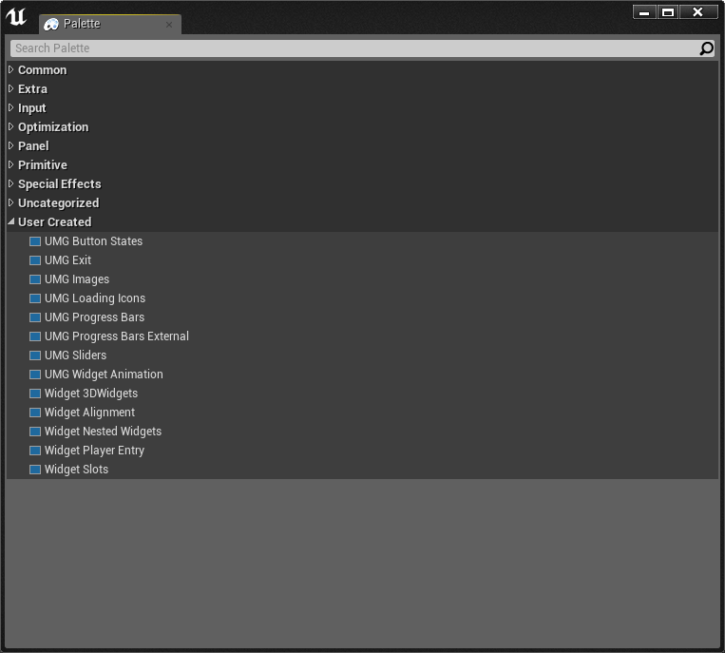
Extended Input Widgets
User Created Widgets
Input Widgets
User Widgets
Input Widgets, such as Buttons, Text Boxes, and Combo Boxes, take user input through the keyboard and mouse.
User Widgets are Widgets made within UMG, which can be reused many times and placed within other User Widgets.

Slide 12
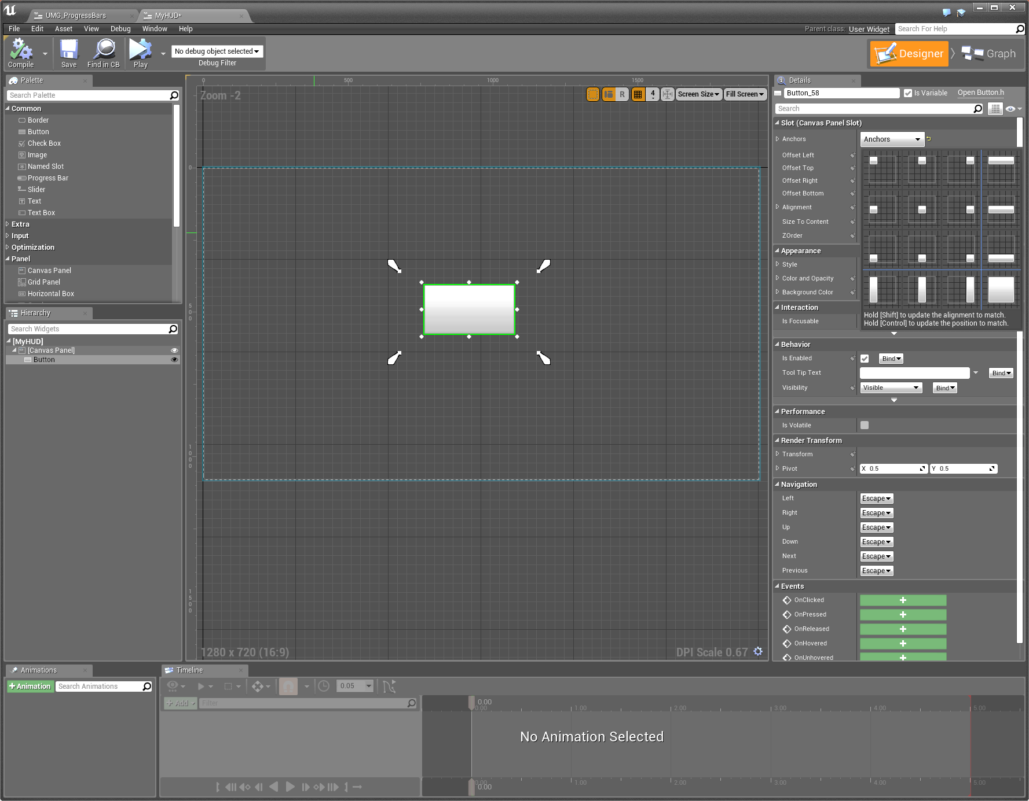
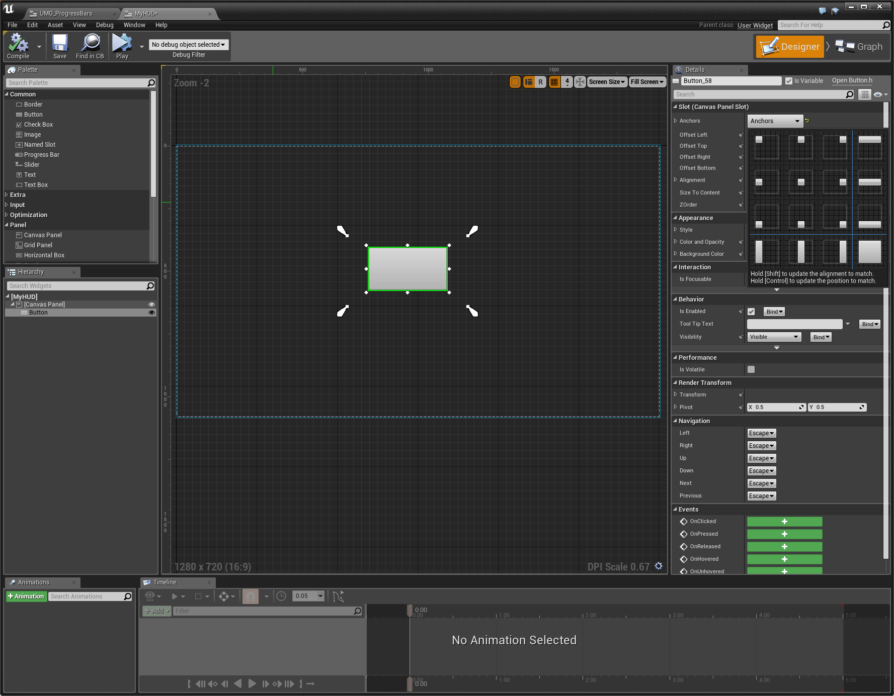
Anchors
Anchors are used to define a UI Widget’s desired location on a Canvas Panel and maintains that position with varying screen sizes. Anchors are normalized where Min(0,0) and Max(0,0) is the upper left corner and Min(1,1) and Max(1,1) is the bottom right corner.
Once you have a Canvas Panel and add other UI Widgets to it, either you can select from a number of preset Anchor positions (typically, selecting one of these should do if you only want to keep your Widget at a specific location) or you can manually set the Anchor position and Min/Max settings as well as applying offsets.
Using Anchors in UMG

Slide 13
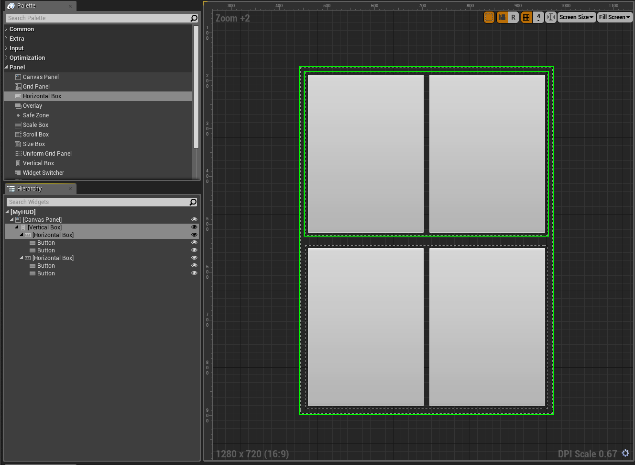
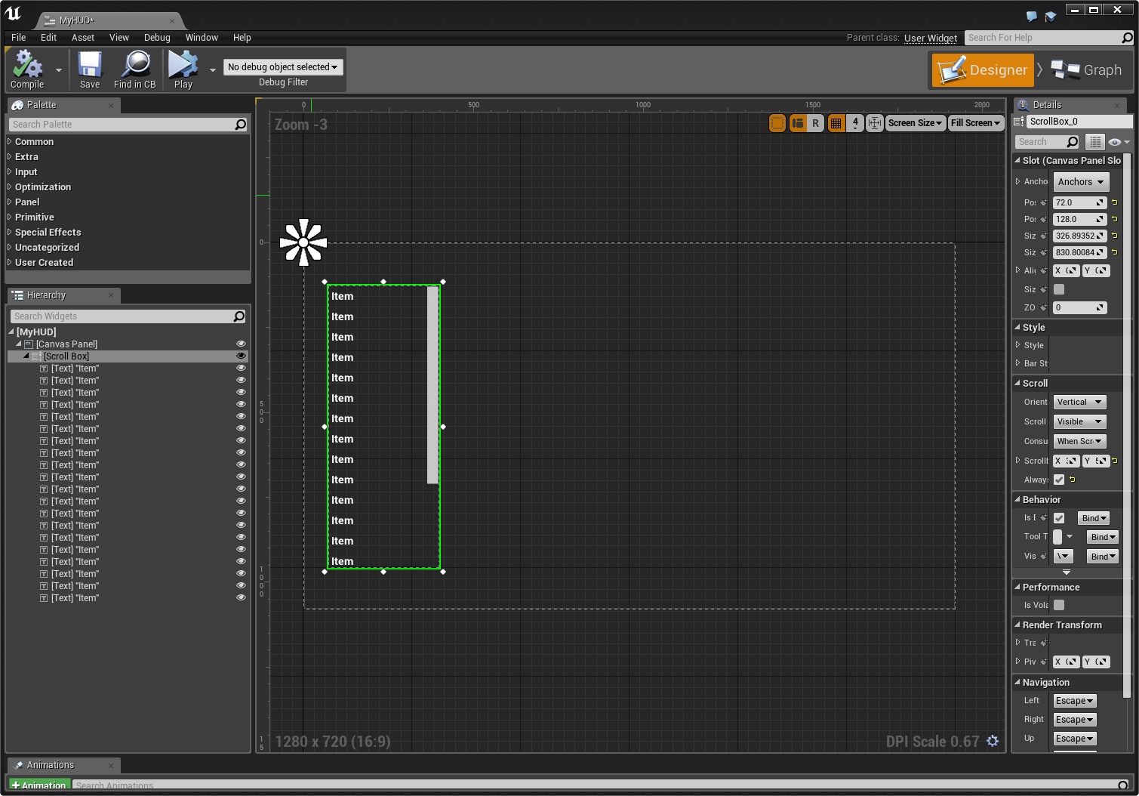
An example of the Horizontal and
Vertical Box Widgets
An example of the Scroll Box Widget
Horizontal/Vertical Box
Scroll Box
A Horizontal/Vertical Box allows child Widgets to be laid out in a flow horizontally/vertically. The order of the flow will match the order the child Widgets are listed in.
A Scroll Box is a collection of Widgets than can scroll horizontally or vertically if the space the child Widgets require exceeds the bounds of the scroll box.

Slide 14
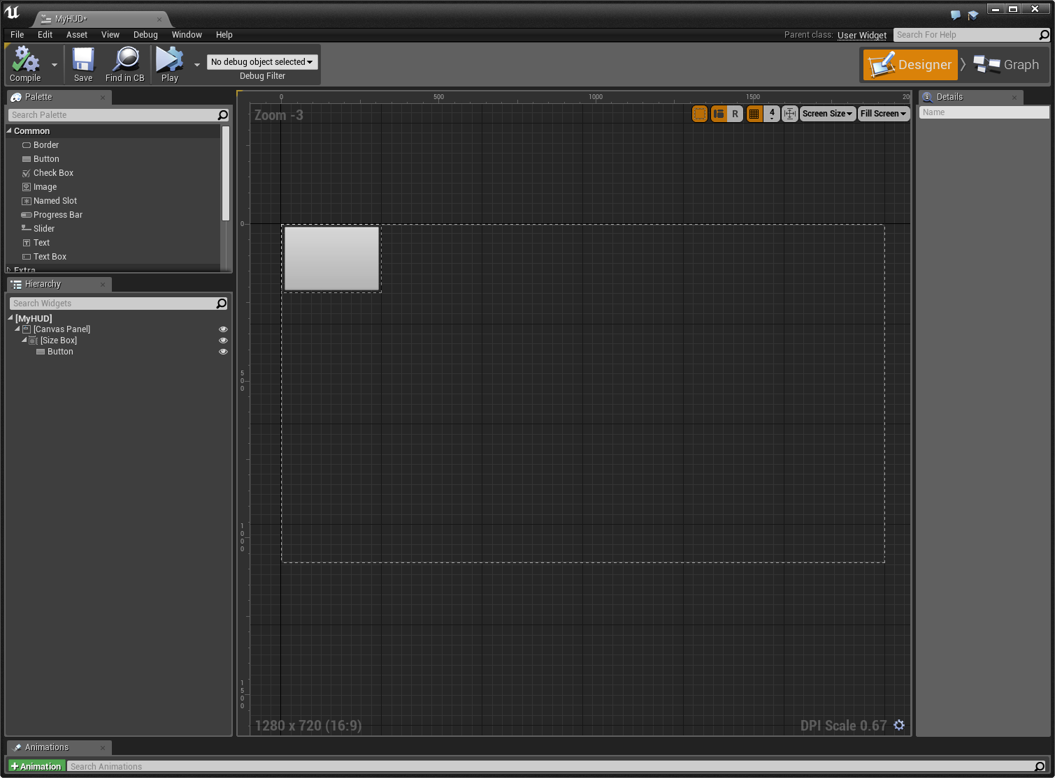
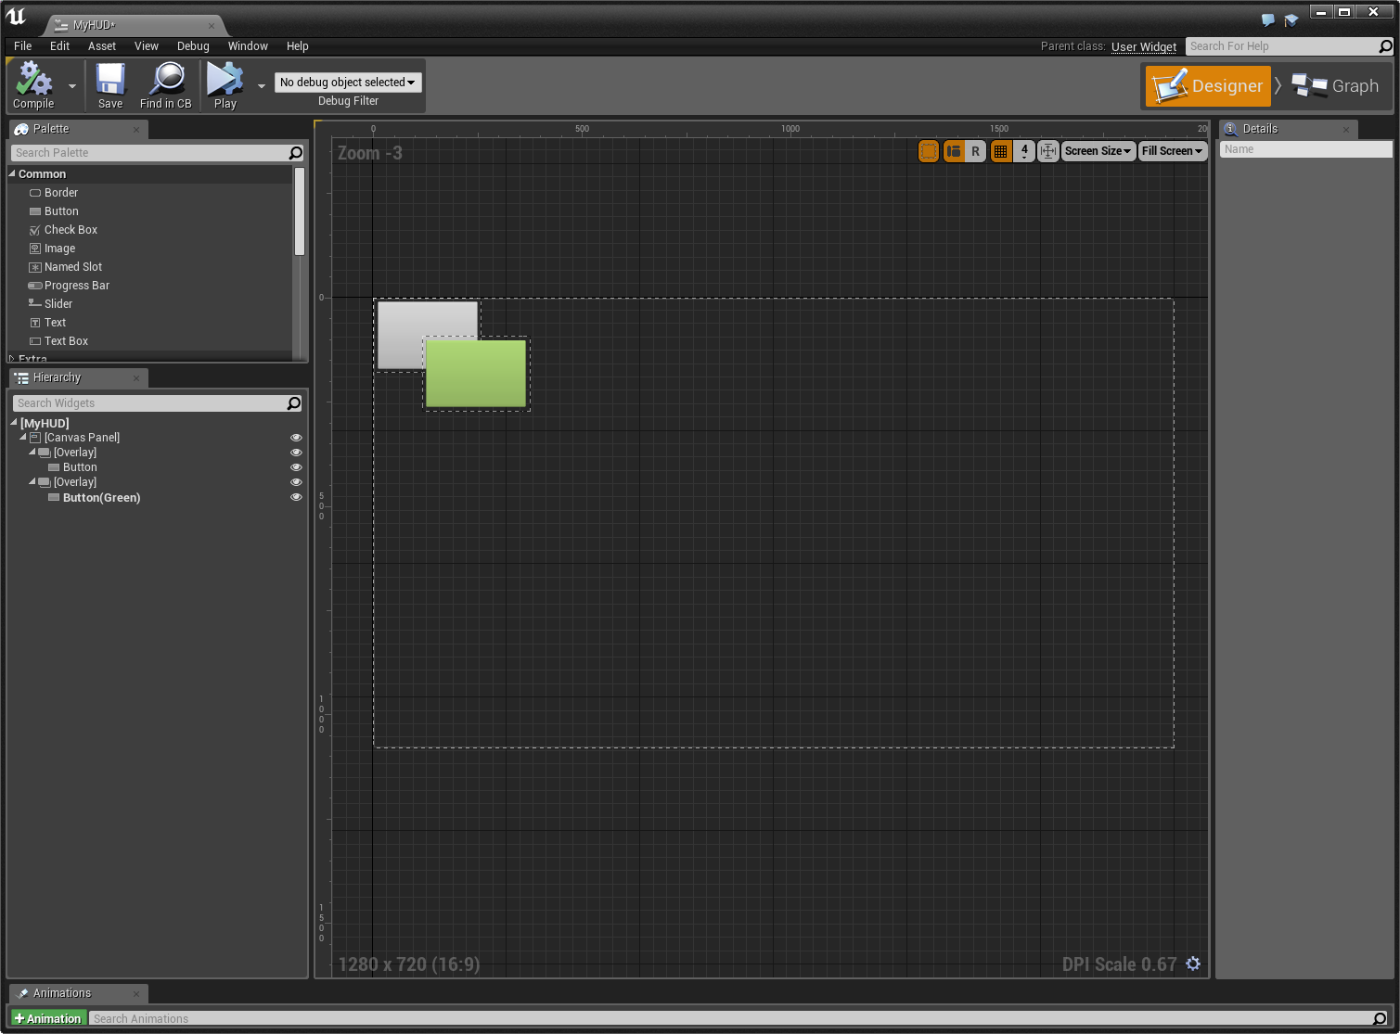
An example of the Size Box Widget
An example of the Overlay Widget
Size Box
Overlay
A Size Box contains only a single Slot and forces the contained Widget in that Slot to have a specific size.
An Overlay allows child Widgets to be stacked on top of each other and uses a simple flow layout for content on each layer.

Slide 15
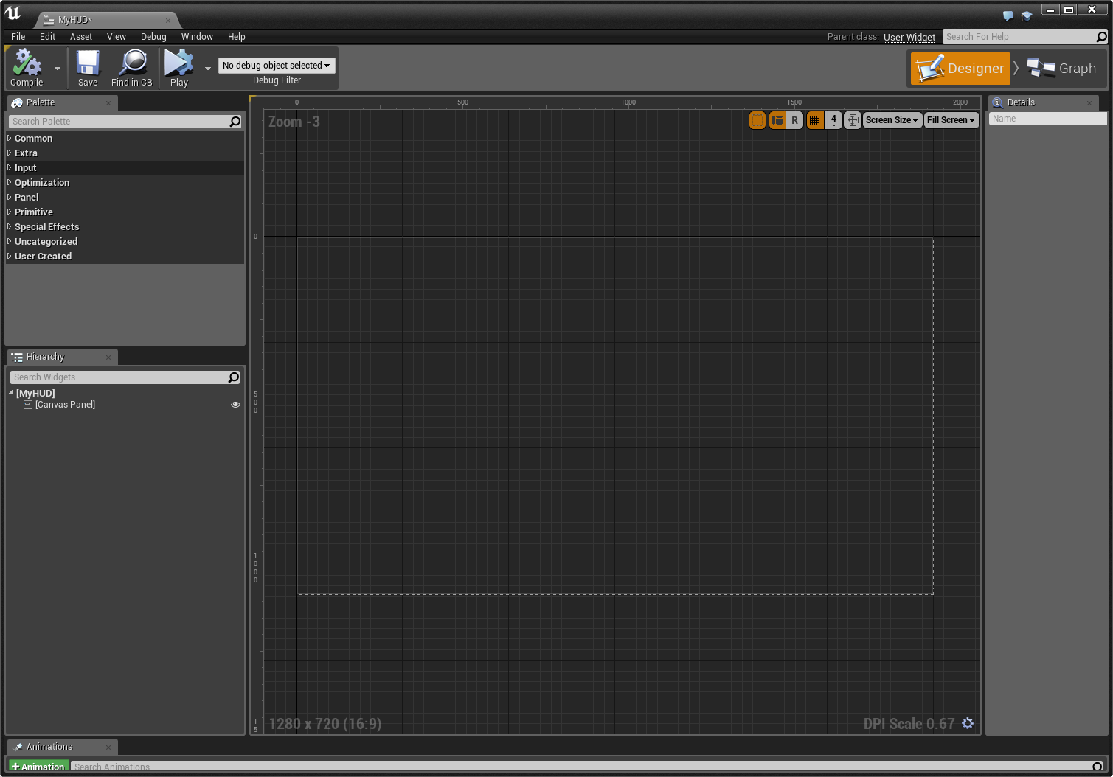
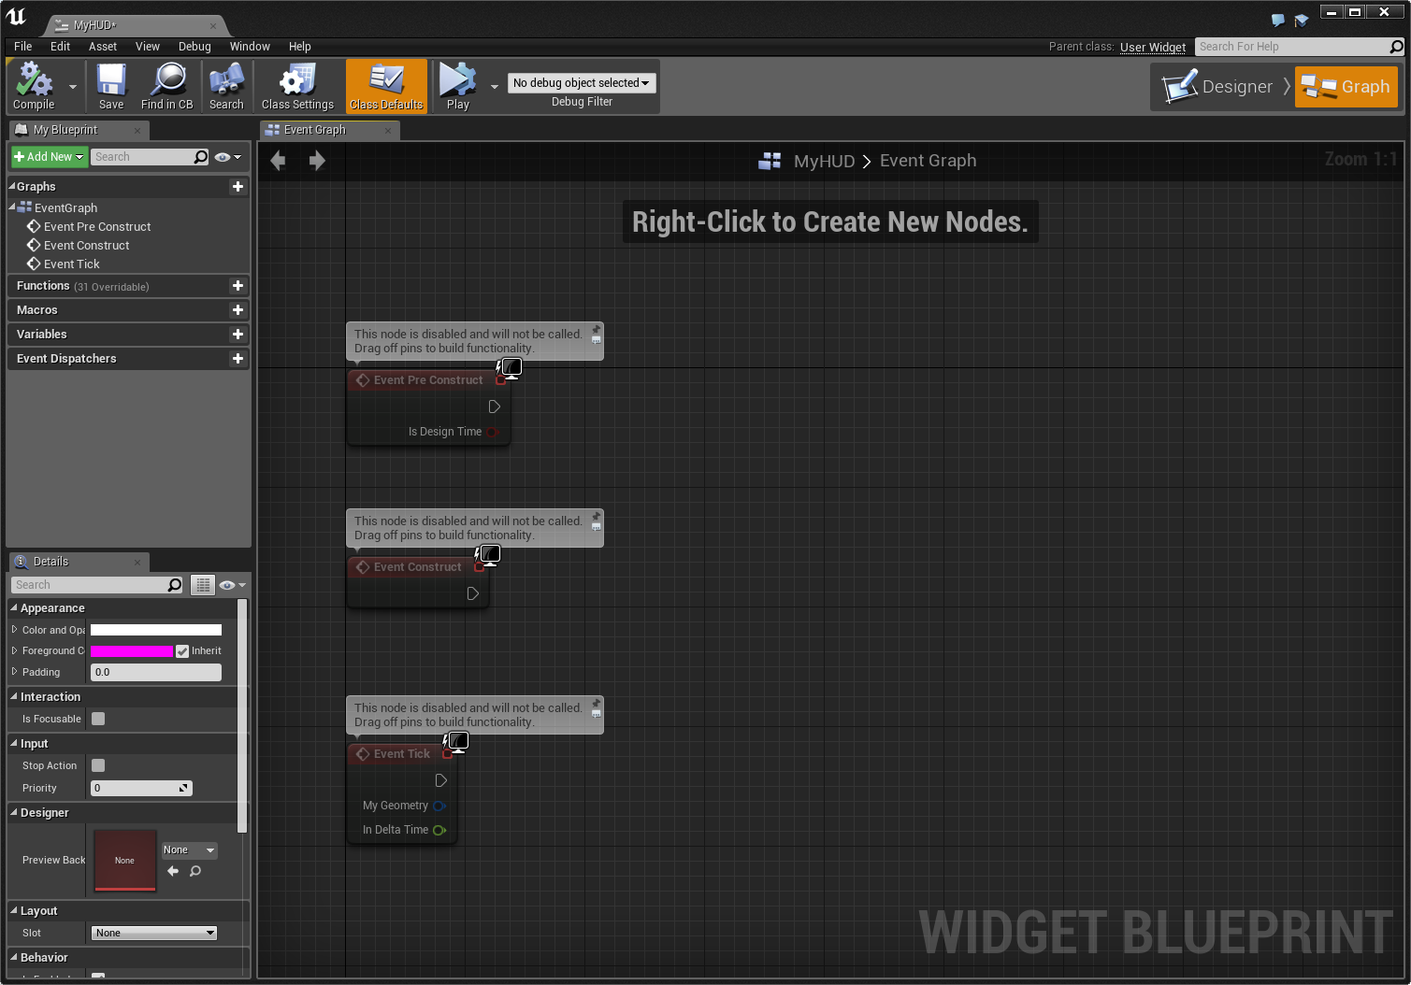
The interface for the UMG Designer
The interface for the UMG Event Graph
Designer
Event Graph
The Designer is where Widgets are composited and configured. It provides a “what you see is what you get” (WYSIWYG) editor.
The Event Graph is a Blueprint editor interface for controlling the behavior of Widgets and reacting to input events from players.

Slide 16
Input between game and UI must be carefully directed and controlled.
Focus indicates what component of the game is allowed to capture the input from controllers, mice, and keyboards. For example, a mouse is often used in a game to control aim; however, it is also often used to control the cursor in a menu. Doing both at the same time would be confusing and problematic for the player, so Focus allows a developer to explicitly set what should be using the input.
Once UMG is given input focus, it is still necessary to be even more specific as to which Widget can accept the input events. For example, you can have multiple text entry boxes; which one should the letters being typed using the keyboard appear in? This sort of focus can be set by the user—that is, clicking on that Widget using a cursor—and it can also be set programmatically.
Once a Widget has focus, it can receive input events and define behavior tied to those events using blueprints in the Graph Editor within the UMG Editor.

Slide 17
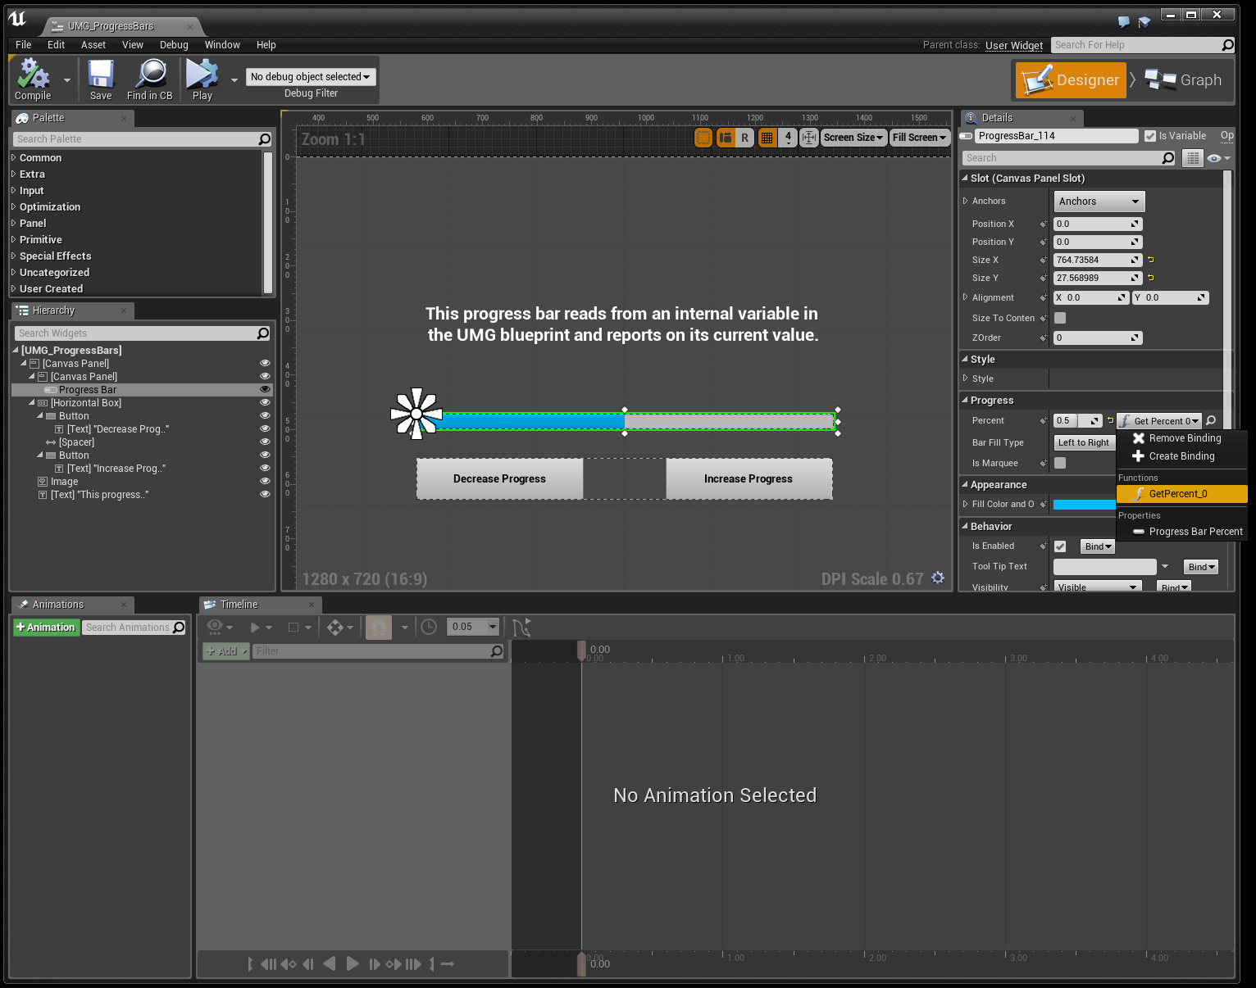
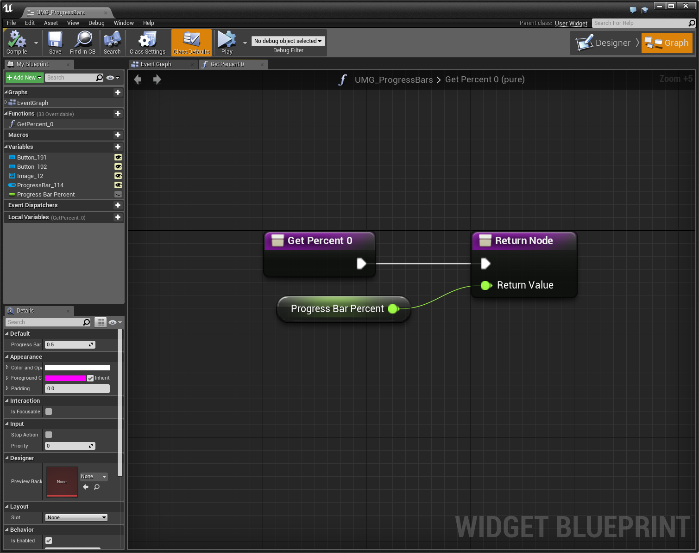
Binding of Properties
One of the most useful aspects inside UMG is the ability to bind properties of your Widgets to functions or variables inside the Blueprint. By binding a Widget’s property to a function or variable in your Blueprint, anytime that function is called or variable is updated, it will be reflected in the Widget.
Property Binding in UMG

Slide 18
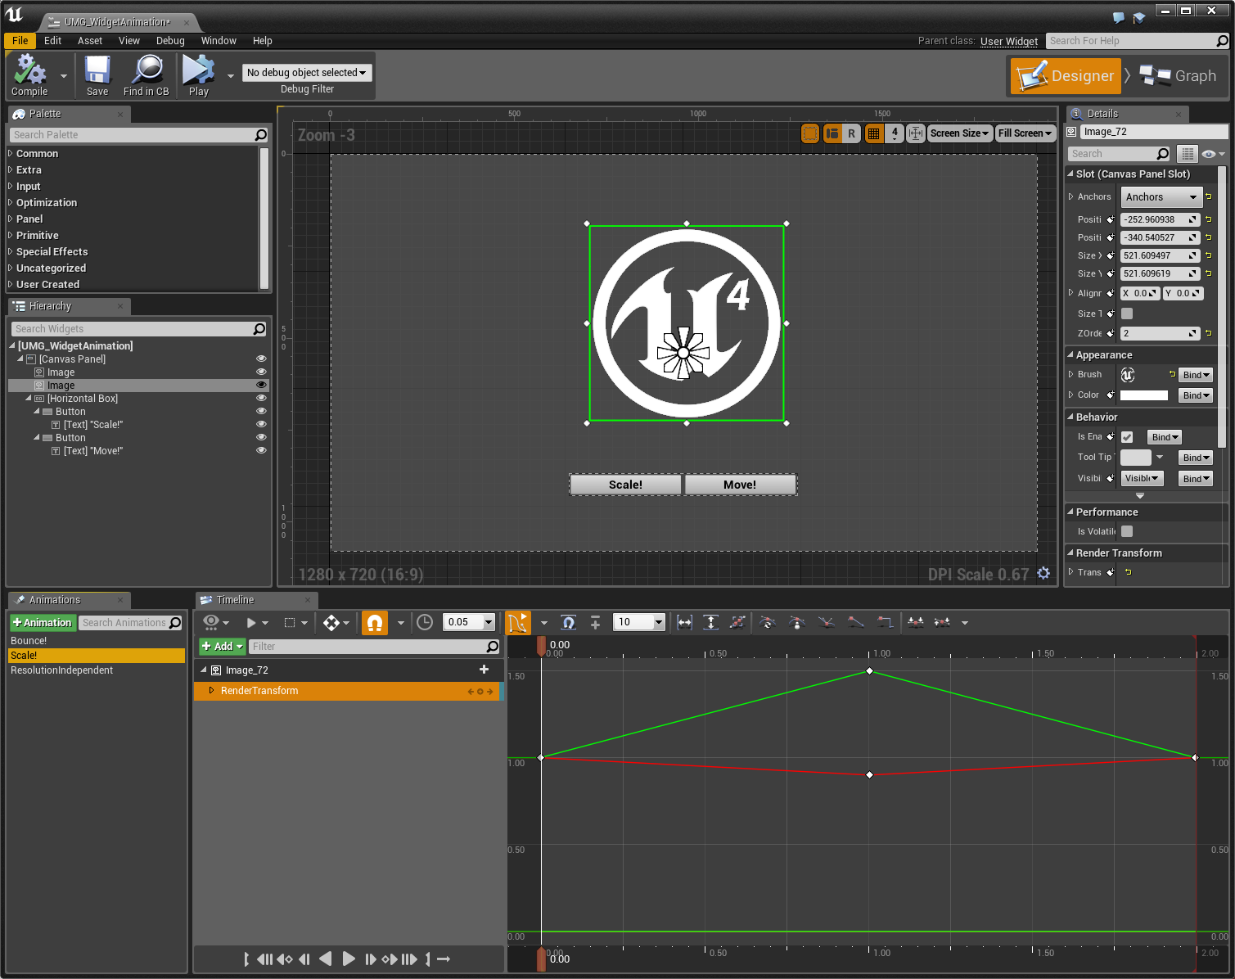
Animation
Located along the bottom of the Widget Blueprint Editor are two windows that allow you to implement and control animations for your UI Widgets.
The first, the Animations window, allows you to create essentially animation tracks, which are used to drive the animation of your Widgets.
The second, the Timeline window, is how an animation is applied to a Widget over time, which is done by placing Keyframes at specified times and then defining how the attached Widget should appear at that Keyframe (this could be size, shape, location, or even coloring options).
Timeline Animation in the UMG Designer

Slide 19
Conclusion
Questions?

